Slide 1
compiler

Slide 2
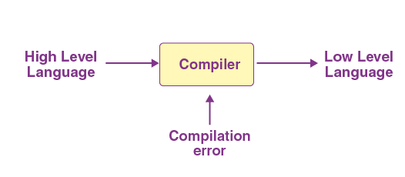
What is a Compiler?
A compiler is a computer program that decodes computer code composed in one programming language into another language. Or we can say that the compiler helps in translating the source code composed in a high-level programming language into the machine code.

Slide 3
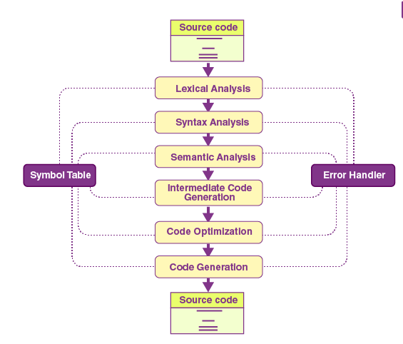
the Phases of Compiler
The 6 phases of a compiler are:
Lexical Analysis
Syntactic Analysis or Parsing
Semantic Analysis
Intermediate Code Generation
Code Optimization
Code Generation

Slide 4
lexical analysis
Lexical analysis or Lexical analyzer is the initial stage or phase of the compiler.
This phase scans the source code and transforms the input program into a series of a token.
A token is basically the arrangement of characters that defines a unit of information in the source code.
NOTE: In computer science, a program that executes the process of lexical analysis is called a scanner, tokenizer, or lexer.

Slide 5
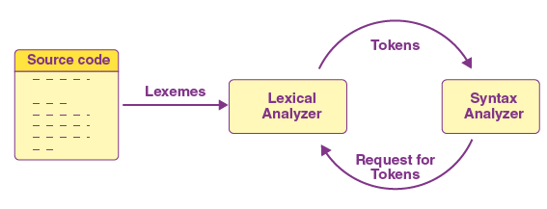
Roles and Responsibilities of Lexical Analyzer
It is accountable for terminating the comments and white spaces from the source program.
It helps in identifying the tokens.
Categorization of lexical units.

Slide 6
syntax analysis
In the compilation procedure, the Syntax analysis is the second stage. Here the provided input string is scanned for the validation of the structure of the standard grammar. Basically, in the second phase, it analyses the syntactical structure and inspects if the given input is correct or not in terms of programming syntax.
It accepts tokens as input and provides a parse tree as output. It is also known as parsing in a compiler.

Slide 7
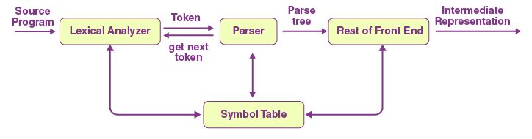
Roles and Responsibilities of syntax analyzer
Note syntax errors.
Helps in building a parse tree.
Acquire tokens from the lexical analyzer.
Scan the syntax errors, if any.

Slide 8
Semantic analysis
In the process of compilation, semantic analysis is the third phase.
It scans whether the parse tree follows the guidelines of language.
It also helps in keeping track of identifiers and expressions.
In simple words, we can say that a semantic analyzer defines the validity of the parse tree, and the annotated syntax tree comes as an output.

Slide 9
Roles and Responsibilities of semantic analyzer
Saving collected data to symbol tables or syntax trees.
It notifies semantic errors.
Scanning for semantic errors.

Slide 10
Intermediate code generation
The parse tree is semantically confirmed; now, an intermediate code generator develops three address codes.
A middle-level language code generated by a compiler at the time of the translation of a source program into the object code is known as intermediate code or text.
A code that is neither high-level nor machine code, but a middle-level code is an intermediate code.
We can translate this code to machine code later.
This stage serves as a bridge or way from analysis to synthesis.

Slide 11
Roles and Responsibilities
Helps in maintaining the priority ordering of the source language.
Translate the intermediate code into the machine code.
Having operands of instructions.

Slide 12
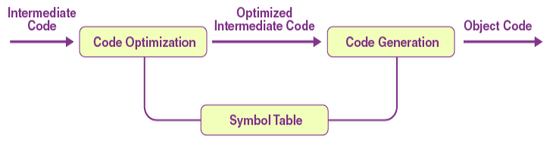
code optimizer
Code Optimization phase is totally optional.
It is used to enhance the intermediate code. This way, the output of the program is able to run fast and consume less space.
To improve the speed of the program, it eliminates the unnecessary strings of the code and organises the sequence of statements.

Slide 13
Roles and Responsibilities
Remove the unused variables and unreachable code.
Enhance runtime and execution of the program.
Produce streamlined code from the intermediate expression.

Slide 14
code generator
The final stage of the compilation process is the code generation process.
In this final phase, it tries to acquire the intermediate code as input which is fully optimised and map it to the machine code or language.
Later, the code generator helps in translating the intermediate code into the machine code.
Roles and Responsibilities:
Translate the intermediate code to target machine code.
Select and allocate memory spots and registers.

Slide 15
Symbol table
The symbol table is mainly known as the data structure of the compiler. It helps in storing the identifiers with their name and types. It makes it very easy to operate the searching and fetching process.
The symbol table connects or interacts with all phases of the compiler and error handler for updates. It is also accountable for scope management.
It stores:
It stores the literal constants and strings.
It helps in storing the function names.
It also prefers to store variable names and constants.
It stores labels in source languages.

Slide 16
Objective of Symbol table
A symbol table serves the following objectives:
It verifies whether a variable has been declared.
It stores all entities' names in a structured form in a single place.
It determines the scope of a name.
It implements type checking by verifying whether the assignments and expressions in the source code are semantically correct or not.
It may be included in a process output to be used later during debugging sessions.
It serves as a resource for creating a diagnostic report during or after program execution.

Slide 17
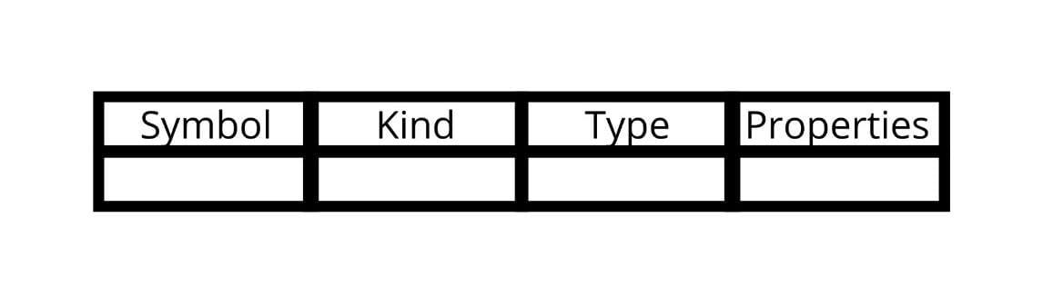
Format of Symbol table
A symbol table is simply a table which can be either linear or a hash table. Each item in the symbol table has properties like name, kind, type, and others, like the image added below.

Slide 18
Symbol table operation
insert()
The operation insert( ) inserts information in the table about unique names occurring in the code. The format in which the names are stored depends on the compiler. The analysis phase, i.e., the first half, where tokens are identified, and names are stored in the symbol table more frequently uses this operation. The attributes of a symbol are information associated with the symbol like state, scope, type, etc. The symbols and attributes of the symbols are the arguments of the insert() function. Take, for example, the user writes int a; in the code.
Now, the compiler processes this as insert(a, int);

Slide 19
Symbol table operation
lookup()
The lookup() operation's primary function is to search for a name in the symbol table. The lookup() function format varies from language to language. The basic format is lookup(symbol). The function returns zero if the entered symbol does not exist in the table, and if it does, it returns its attributes stored in the table. The lookup() function also determines-
If the symbol is declared before it is being used.
If the name is used in the scope.
If the symbol is initialized.
If the symbol is declared multiple times.

Slide 20
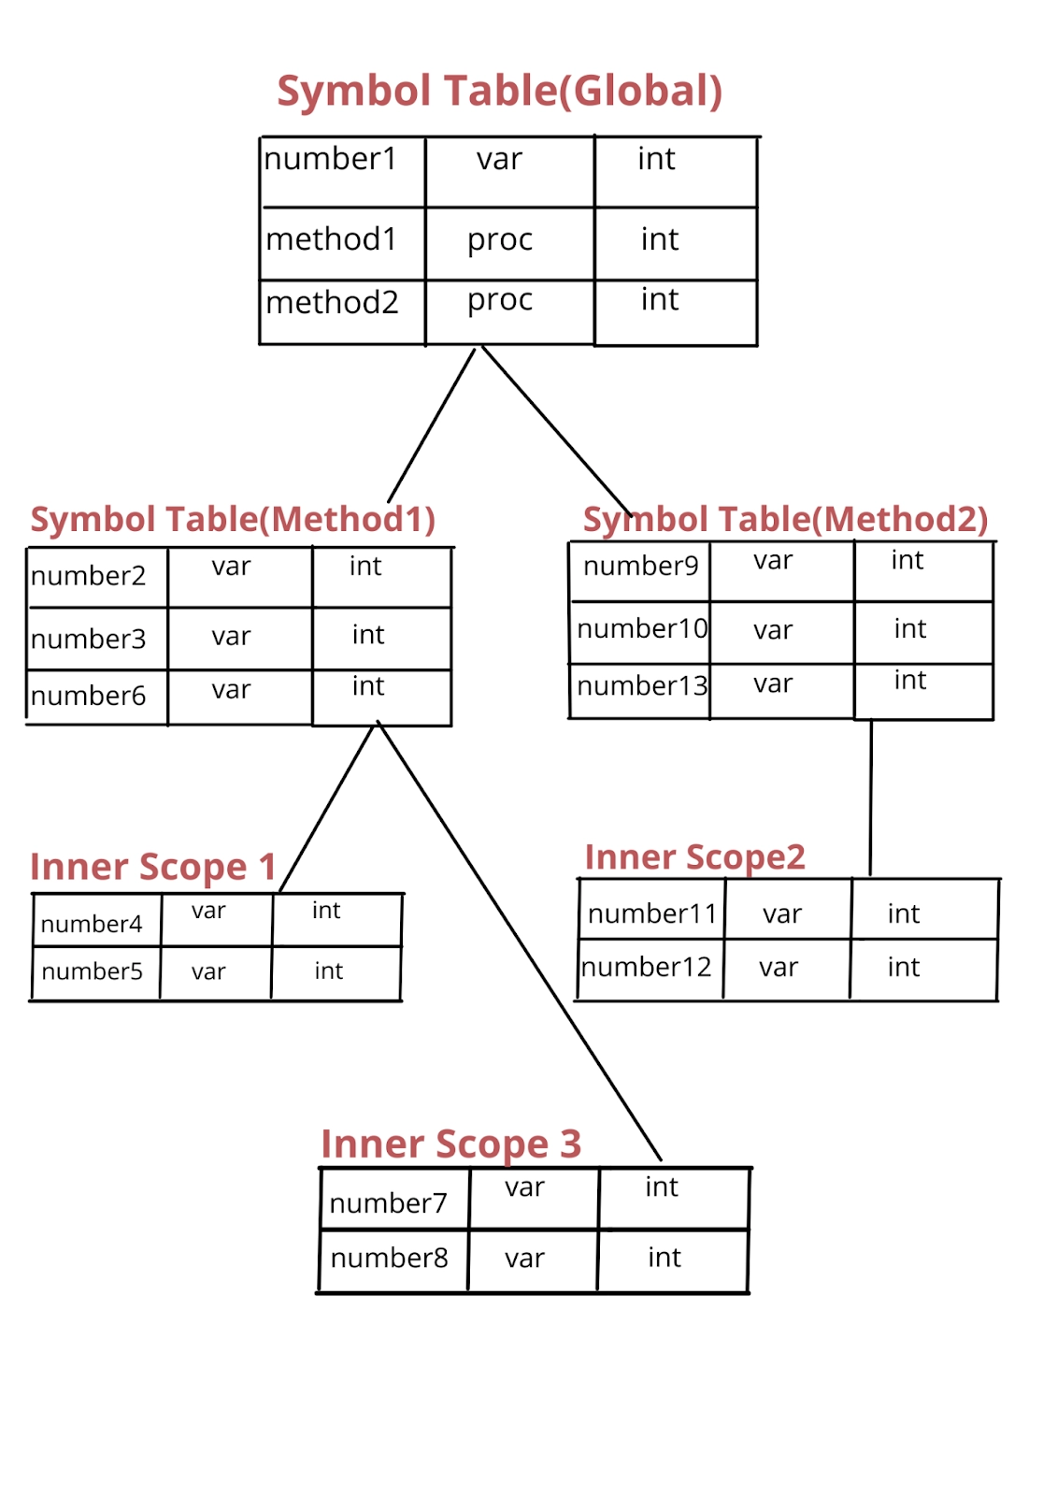
Data structures
Data Structures used for the implementation of symbol tables are- 1. Binary Search Tree 2. Hash Tables

Slide 21
Working Example
X = a + b * 50;
Symbol Table:
S.No. | Variable name | Variable type
1 | x | float
2 | a | float
3 | b | float

Slide 22
Working Example
Lexical Analyzer:
x -> Identifier- (id, 1)
= -> Operator - Assignment
a -> Identifier- (id, 2)
+ -> Operator - Binary Addition
b -> Identifier- (id, 3)
* -> Operator - Multiplication
10 -> Constant - Integer
final tokenized expression is given below.
(id, 1) = (id, 2) + (Id, 3)*50

Slide 23
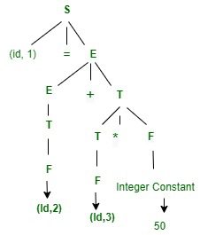
Working Example
2. Syntax Analyzer:
S -> Id = E
E -> E+T | T
T -> T*F | F
F -> Id | Integer constant
SDT for the above expression is

Slide 24
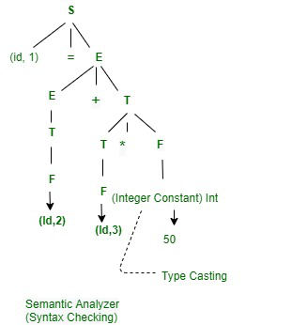
Working Example
3. Semantic Analyzer:

Slide 25
Working Example
4. Intermediate Code Generator : 3 Address Code –
t1 = b * 50.0
t2 = a+t1
x = t2
5. Code Optimizer : I.t1 = b* 50.0
x = a+ t1
6. Target Code Generator : The final expression into assembly code.
Mul
Add
Store

